Slide 1
WEEK 1
Mobile Application Architecture

Slide 2
Chapter Outline
Mobile Application
Mobile Application Architecture

Slide 3
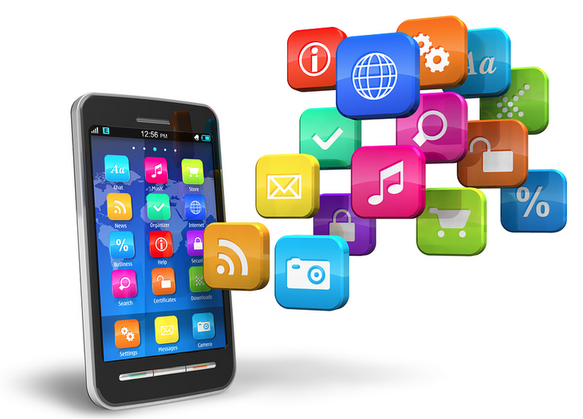
What is Mobile Application?
A mobile application, most commonly referred to as an app, is a type of application software designed to run on a mobile device, such as a smartphone or tablet computer.
The history of the mobile app begins, obviously, with the history of the mobile device and the first mobile phones whose microchips required the most basic of software to send and receive voice calls. But since then things have got a lot more complicated.

Slide 4
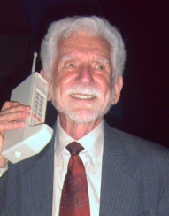
History of Mobile Application
The first public cellular phone call was made by Martin Cooper of Motorola on 3rd April 1973 in a publicity stunt in New York.
The DynaTAC 8000X weighed in at around 2 pounds, cost $4,000 and didn’t run any apps.

Slide 5
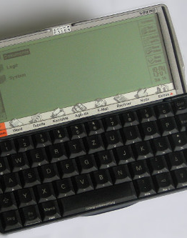
History of Mobile Application (2) - Psion
The first recognisable apps came with Psion’s range of handheld computers – mostly PDAs – that used the EPOC operating system.
First released in the early 90s the sixteen bit machines (SIBO) which ran EPOC allowed users programmes such as a word processor, database, spreadsheet and diary.
Later models in the range, running a 32-bit OS, would come with up to 2MB RAM and allow users to add additional apps via software packs (or via download if you were lucky enough to own a modem).

Slide 6
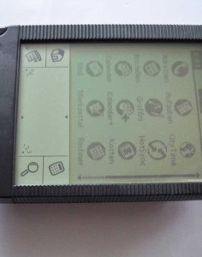
History of Mobile Application (3) - Palm
Palm emerged as a major rival to Psion in the PDA market with its cheaper, lower functionality range of PDAs – the Palm Pilot.
Commercial success allowed Palm to release a new generation of machines in 1996 which utilised the Palm OS. This had a touchscreen GUI and came with a raft of basic apps as well as tons of third party apps programmed in C/C++.

Slide 7

History of Mobile Application (4) – J2ME
As feature phones got faster the possibilities for phone apps expanded and it was Java Micro Edition that won the race to provide a platform for developing them.
Java ME started life as JSR 68, replaced Personal Java and quickly became so popular that it evolved into numerous standards for use across phones, PDAs and other embedded devices like set top boxes.
JME was the undisputed king of mobile platforms, it’s used in the Bada and Symbian operating systems and implementation existed for Windows CE, Windows Mobile and Android.

Slide 8
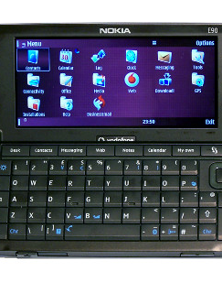
History of Mobile Application (5) – Symbian
As mentioned earlier, Symbian grew out of the Psion EPOC operating system. Originally developed by Symbian Ltd – a joint venture of Psion, Ericsson, Motorola and Nokia. In 2009 250 million devices were running Symbian.
It was Nokia that really drove the development of Symbian OS. The S60 platform was used on nearly all Nokia handsets as well as some Samsung and LG ones.
The incompatibility of apps across platforms and the failure to fully move to open source (several key components were licensed from third parties) are probably what sounded the death-knell for Symbian.

Slide 9
https://www.youtube.com/watch?v=f0DA-va7txM&ab_channel=GhostLead

Slide 10
History of Mobile Application (6) – Android
Based on the Linux kernel, Android started life as a proposed advanced operating system for digital cameras until the company realised that the market was limited compared to that for mobile phones.
The Open Handset Alliance unveiled the Android operating system in 2007, nearly two years after Google’s acquisition of Android. (The launch of Google’s foray into the mobile world was delayed by the launch of the iPhone which radically changed consumers’ expectations of what a smartphone should do.)
Google faced down a copyright infringement suit from Oracle over the Java-compatible nature of the Androids APIs. Rather than straight up Java APIs Android uses Apache Harmony and the Dalvik virtual machine which translates Java bytecode into Dalvik executable.

Slide 11
History of Mobile Application (6) – Android
Pros
Cons
Android has a dominant share of the mobile market – 81% of all devices shipped in Q3 2013 were Android.
You can develop on any platform.
The environment is more open: call history is available to all apps; notifications between apps are possible as well as the sharing of content; apps can be installed from any source.
Fragmentation between different versions of the OS, which are often significantly different, are a major problem.
Upgrades are passed through manufacturers and carriers who add their own customisations, delaying the process.
App developers are forced to try to accommodate users whose OS versions are years apart (as opposed to iOS where most users upgrade to the new version within weeks of the release).

Slide 12
History of Mobile Application (7) – iOS
Apple’s iPhone set the standard for the new generation of smartphones when it was first released in June 2007 with its touchscreen and direct manipulation interface. There was no native SDK until February of 2008 (Apple initially planned to provide no support for third-party apps).
The main programming language for iOS is Objective C. Development is done through Xcode IDE which has an in-built iOS simulator.

Slide 13
History of Mobile Application (7) – iOS
Pros
Cons
Less fragmentation arising from upgrades – 80% of users are on the latest version.
New features are usually available very quickly.
The OpenGL API is standard for graphics across the platform.
iOS is a more closed platform – there are limited possibilities for inter-app communication and private APIs are automatically rejected by the App Store.
Development can only be done on a Mac.
Duplicating core iPhone features is prohibited.
You need to subscribe to the iOS developer programme (annual fee) to publish apps and App Store guidelines can be difficult to understand.

Slide 14
https://www.youtube.com/watch?v=MMyMB4zm9so&ab_channel=DataIsBeautiful

Slide 15
Type of Mobile Apps
Native Apps
Hybrid Apps

Slide 16
Native App
A native app is a smartphone application developed specifically for a mobile operating system (think Objective-C or Swift for iOS vs. Java for Android).
Since the app is developed within a mature ecosystem following the technical and user experience guidelines of the OS, it not only has the advantage of faster performance but also “feels right”.
What feeling right means is that the in-app interaction has a look and feel consistent with most of the other native apps on the device. The end user is thus more likely to learn how to navigate and use the app faster.

Slide 17
Hybrid App
Hybrid applications are, at core, websites packaged into a native wrapper.
A hybrid app is a web app built using HTML5 and JavaScript, wrapped in a native container which loads most of the information on the page as the user navigates through the application (Native apps instead download most of the content when the user first installs the app).

Slide 18
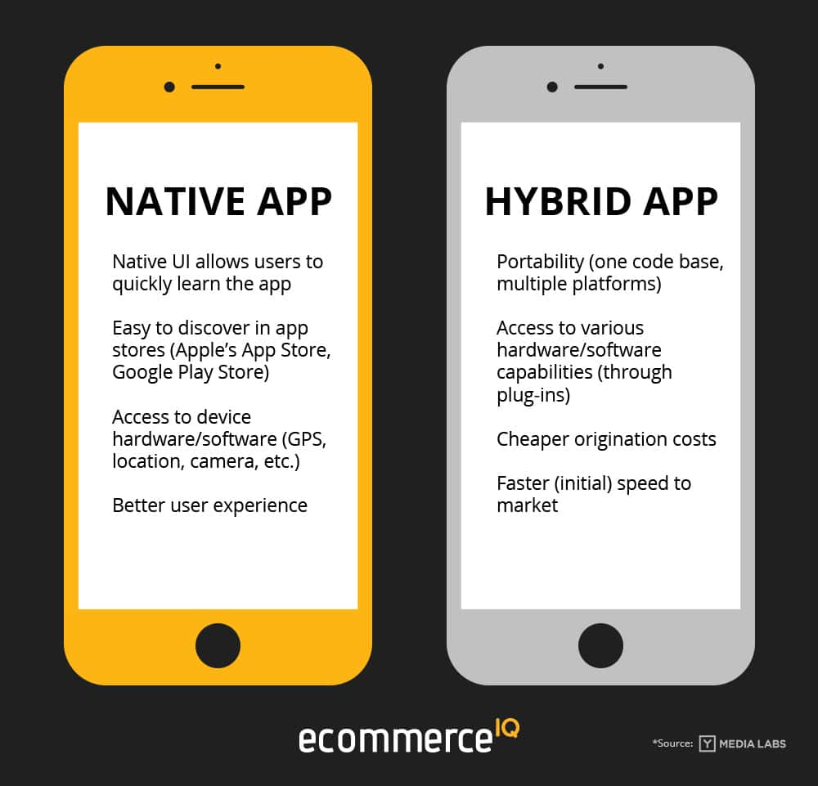

Slide 19
Client-Server Architecture

Slide 20
Introduction
We will review several interesting architectural patterns and describe why they are useful as general mobile application architecture solutions.

Slide 21
Mobile Application Architecture
Mobile Application can be implemented using one, two, or three layers of application code.
However, if you only use one layer it is extremely difficult to isolate the individual areas of functionality and reuse and distribute the code over multiple device types
The layers are using Model-View-Controller (MVC) architecture: Presentation, Business, Data Access

Slide 22
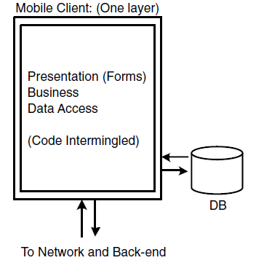
Mobile Application – One layer

Slide 23
Mobile Application– Two layers

Slide 24
Mobile Application– Three layers

